Slide 1

Leading with Positivity
The Power of Positive Psychology
MS | Leadership & Management Techniques
Notes:
TIME: 0:00 to 0:02 (2 min)
OPEN BEFORE YOU SHOW ANYTHING SUBSTANTIVE. Ask the room: "Raise your hand if you have ever had a manager whose mood set the weather for the whole team." Pause and let the laughter and nods land. That is today's subject.
Frame the session: two hours, three parts. First the science (what positive psychology is and why it works), then personal tools (strengths, mindset, optimism, flow), then leading others (safety, gratitude, appreciative inquiry, and the pitfalls). We will do four short activities and one case study, so expect to talk, not just listen.
Housekeeping: tell them you will finish on time because they have their own presentations to deliver. There is a 5-minute break at the halfway mark.
TIP: Step away from the screen during the opening. The slides support you; they are not the show.

Slide 2
By the end of this session
Explain the core ideas of positive psychology, including PERMA and broaden-and-build
1
Use strengths, mindset, and optimism tools to strengthen your own leadership
2
Design practices that build positive, high-performing teams, without toxic positivity
3
Notes:
TIME: 0:04 to 0:06 (2 min)
Read the three objectives aloud and connect each one to a verb: EXPLAIN, USE, DESIGN. Students in a leadership MS program want to leave with something they can do on Monday, so say that explicitly.
The third objective contains the quiet warning of the day: "without toxic positivity." Plant that seed now. Many managers hear "positive leadership" and imagine forced cheerfulness. Tell them the research says almost the opposite: positive leaders are often the most honest ones, because their teams feel safe enough to tell the truth. We will return to this on slide 20.
TRANSITION: "Before I give you any theory, let me ask you to teach me something."

Slide 3

Warm-up: your best leader
Think of the best leader you have ever worked for or learned from.
What did they do?
How did you feel around them?
What did you do differently because of them?
Pair share
3 minutes each way. Then we will collect the themes on the board.
Notes:
TIME: 0:06 to 0:10 (4 min total: 1 min set-up, 3 min pair share; collect themes inside your buffer)
ACTIVITY: Best leader pair share.
SET-UP (30 seconds): Ask everyone to think silently for 20 seconds about the best leader they have ever worked for or learned from. It could be a boss, a teacher, a coach, or a family member.
PAIR SHARE: Each person gets 90 seconds to tell their partner (1) what the leader did and (2) how it felt to be around them. The third question, "what did you do differently because of them?", is the most important one; it shows that leader behavior changes follower behavior.
COLLECT THEMES: Take 4 to 6 words from the room and write them on the board. Expect words like: trust, belief in me, listened, gave credit, high standards, patient, honest, purpose.
THE PAYOFF: Point out that almost none of the words are about technical skill or IQ. They are about positive emotion, relationships, meaning, and strengths, which is exactly what today's science explains. Say: "You already know this. Today we find out why it works, and how to do it on purpose."
Keep the board words visible; refer back to them on slides 7 and 24.

Slide 4
Positivity drives performance
70%
12%
225
of the variation in team engagement is linked to the manager
productivity gain when people were made happier in experiments
studies suggest happiness often comes before success, not only after
Gallup
Oswald, Proto & Sgroi, 2015
Lyubomirsky, King & Diener, 2005
These are associations, not guarantees. Positivity helps; it does not replace good management.
Notes:
TIME: 0:10 to 0:15 (5 min)
THE POINT: Positivity is not a soft extra. It is connected to hard outcomes.
THE THREE NUMBERS (cite the sources aloud):
1. 70%: Gallup's analyses of workplace engagement found that managers account for at least 70% of the variance in team engagement scores. In plain terms, the manager is the single biggest lever. That puts the responsibility squarely on the people in this room.
2. 12%: Oswald, Proto and Sgroi (University of Warwick, 2015) ran experiments in which people were made happier (for example, by watching a short comedy clip) and then completed tasks. Happier people were about 12% more productive. The effect was causal, because happiness was manipulated.
3. 225: Lyubomirsky, King and Diener (2005) reviewed 225 studies. They found that happiness is associated with later success in work, relationships, and health, not just the reverse. People often assume success makes you happy; this suggests happiness also helps produce success.
IMPORTANT CAVEAT (say it out loud; it builds credibility): These are associations and a few experiments, not guarantees. Positivity does not replace clear goals, good processes, or fair pay. It amplifies them.
QUESTION TO ASK THE ROOM (30 seconds): "Which of these three numbers surprises you most?" Take one or two answers.
TRANSITION: "So where did this field come from, and what exactly is it?"

Slide 5
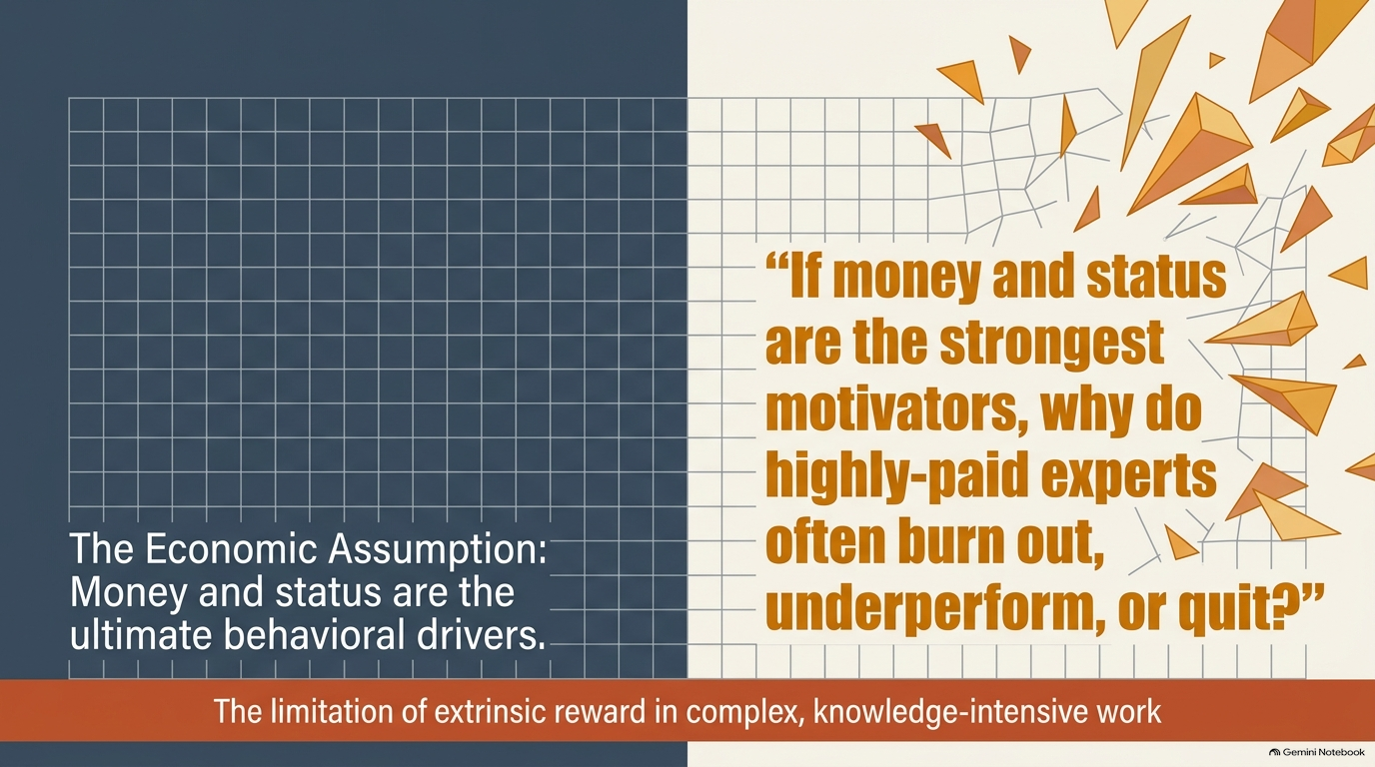

Slide 6
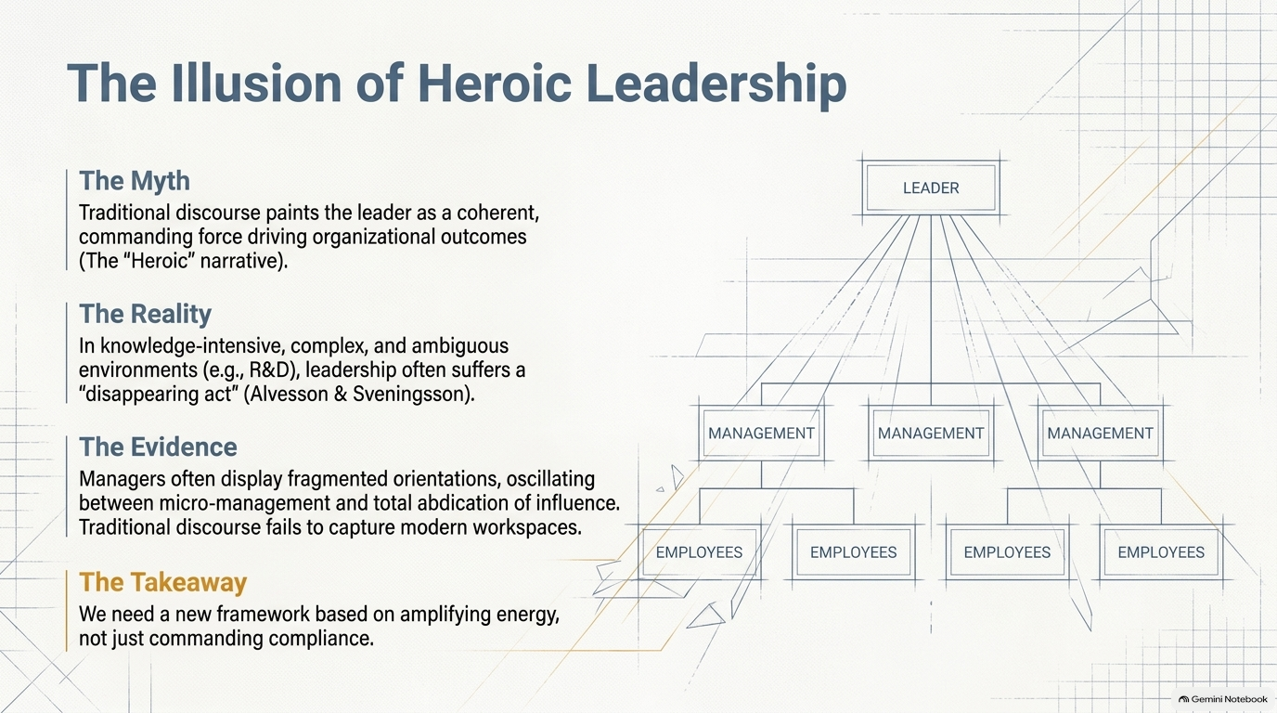

Slide 7
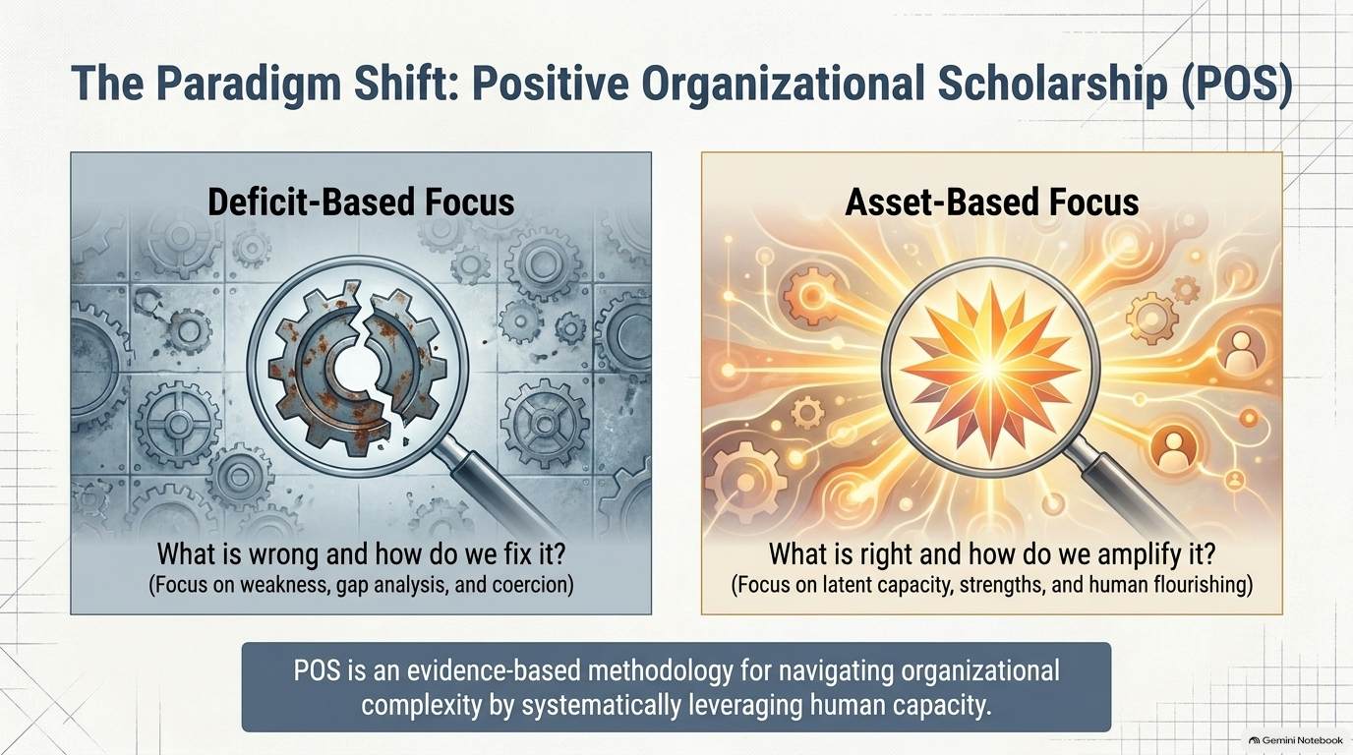

Slide 8
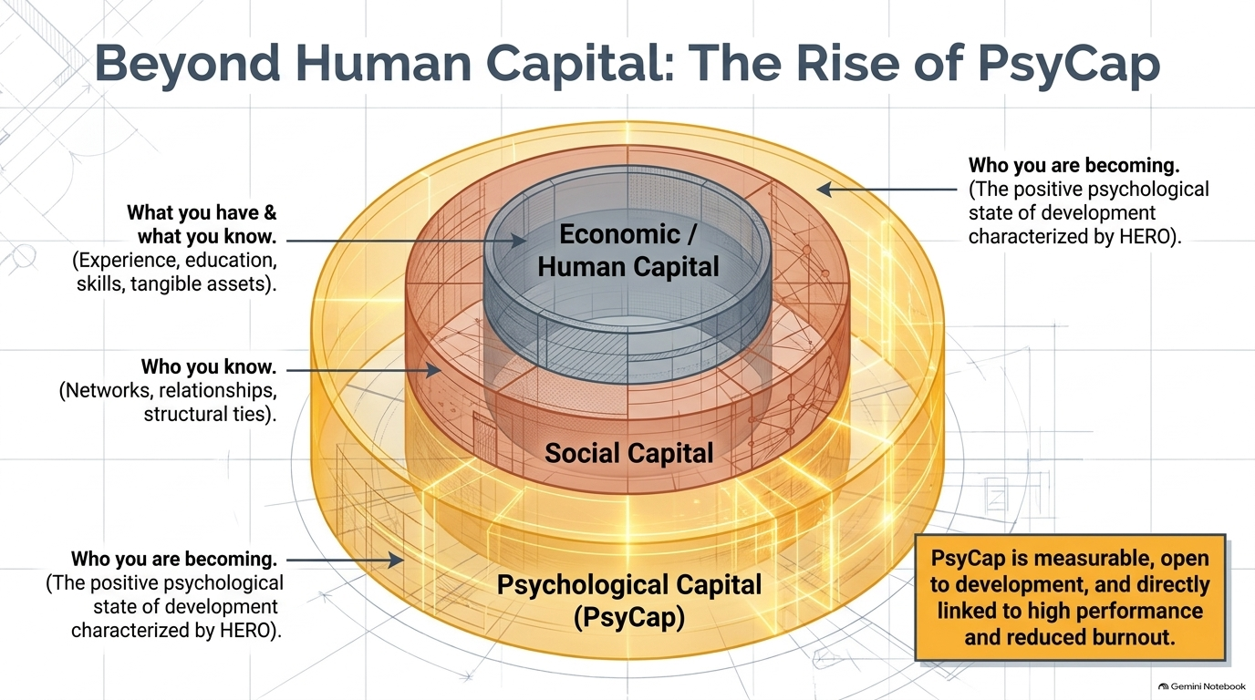

Slide 9
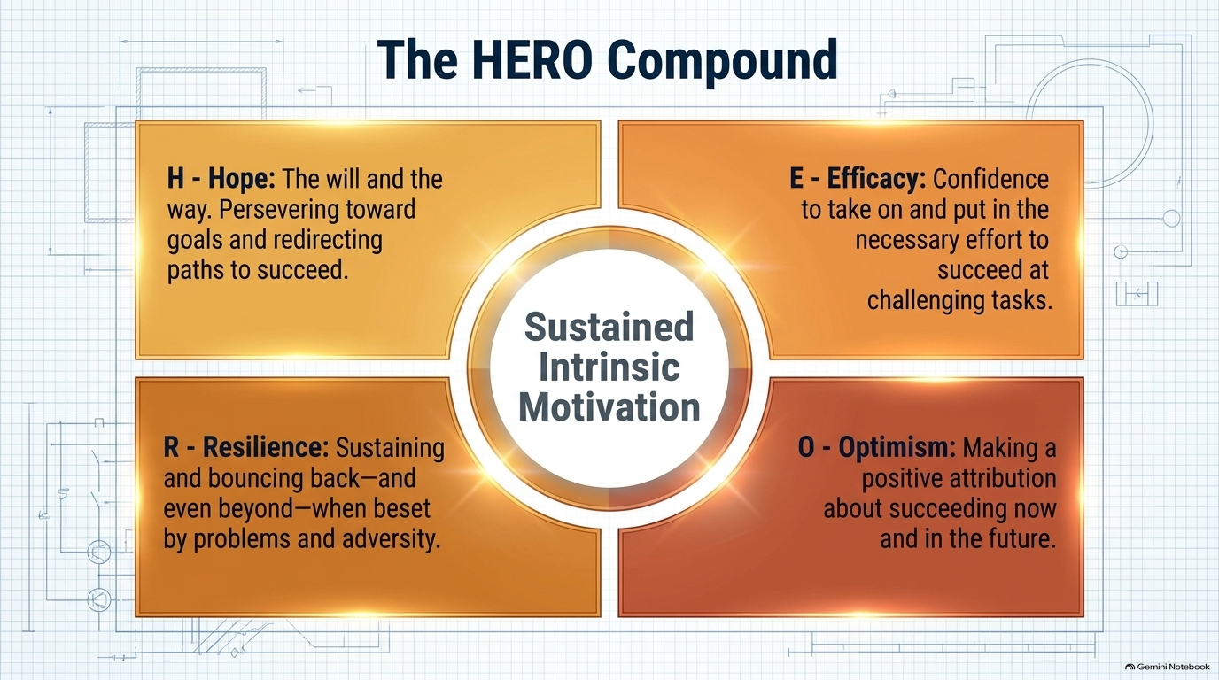
Psychological Capital – Luthans et al.

Slide 10
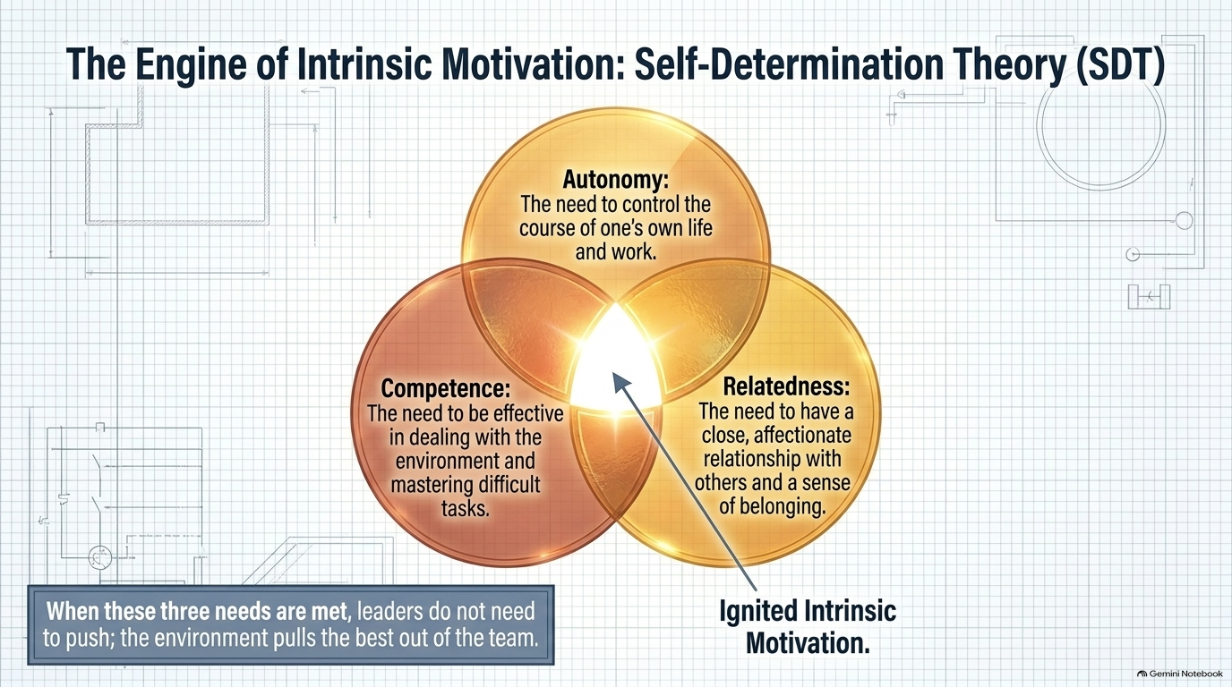
By Deci & Ryan 1985

Slide 11
From fixing to flourishing
Traditional psychology
Reduce suffering: -5 to 0
Positive psychology
Build flourishing: 0 to +5
0
Founding voices
Martin Seligman
Csikszentmihalyi
Christopher Peterson
Launched the field as APA president in 1998
Studied flow and optimal experience
Mapped 24 character strengths with Seligman
Notes:
TIME: 0:15 to 0:19 (4 min)
THE BIG IDEA: For most of the 20th century, psychology focused on what goes wrong: depression, anxiety, trauma, dysfunction. That work saved lives. But it left a gap. Getting someone from -5 to 0 means they are no longer suffering; it does not tell you how to help them thrive at +5.
Use the band graphic: left side is the traditional focus (reduce suffering), right side is the positive psychology focus (build flourishing). Emphasize that it is AND, not OR. Positive psychology does not deny problems; it adds a second question: "What makes life worth living, and how do we build more of it?"
THE FOUNDERS (brief):
- Martin Seligman made well-being the theme of his 1998 presidency of the American Psychological Association. That is usually treated as the field's launch.
- Mihaly Csikszentmihalyi (pronounced roughly "chick-sent-me-high") had been studying optimal experience, which he named "flow." We will meet it later.
- Christopher Peterson worked with Seligman on the classification of character strengths (slide 11).
LEADERSHIP LINK: A leader who only hunts for problems gets a team that hides them. A leader who also looks for what is working gets a team that grows. Ask: "How much of your last team meeting was about problems versus what was going well?"
TRANSITION: "Seligman organized the science into five elements. Here they are."

Slide 12
PERMA: the five building blocks
P
Positive emotion
Joy, gratitude, hope, and curiosity
E
Engagement
Absorption in a meaningful challenge
R
Relationships
Feeling supported, valued, and connected
M
Meaning
Serving something bigger than yourself
A
Accomplishment
Mastery, progress, and goals achieved
book Flourish
Seligman, Flourish (2011)
Notes:
TIME: 0:19 to 0:23 (4 min)
Introduce PERMA from Seligman's 2011 book Flourish. It is a model of well-being with five measurable building blocks. Say the acronym slowly and ask people to remember it by tapping out the letters on their fingers.
P, POSITIVE EMOTION: Not just happiness. It includes gratitude, hope, interest, pride, and amusement. Ask: "Which of these shows up most in your workplace?"
E, ENGAGEMENT: Being absorbed in a task that stretches you; time disappears. This is the flow state (slide 15).
R, RELATIONSHIPS: Feeling supported, valued, and connected to others. Of the five, this is probably the strongest predictor of well-being across studies.
M, MEANING: Belonging to and serving something larger than yourself. For some people that is faith, community, or family; at work it often means seeing who is helped by what you do.
A, ACCOMPLISHMENT: Mastery, progress, and goals achieved, pursued for their own sake.
POINT TO MAKE: Different people lean on different elements. One person is energized by relationships; another by achievement. A good leader notices which block is thin for each team member.
CALLBACK: Look back at the words on the board from the warm-up. Ask students to match two or three of them to a PERMA letter. (For example, "believed in me" maps to Accomplishment; "listened" maps to Relationships.)
TRANSITION: "Okay, that is the theory. What does it look like in an actual team?"

Slide 13






PERMA in your team
Positive emotion
Engagement
Relationships
Open meetings with a win or good news
Match tasks to strengths; protect focus time
Hold real one-to-ones; ask about their lives
Meaning
Accomplishment
Balance
Link every task to the people it helps
Make progress visible; celebrate milestones
Ask “what’s working?” as often as “what’s wrong?”
Notes:
TIME: 0:23 to 0:26 (3 min)
This slide turns each PERMA element into a concrete leader behavior. Read one card each, then invite the room to add their own.
P: Open meetings with a win or good news. It takes 60 seconds and changes the emotional temperature of the room.
E: Match tasks to strengths and protect focus time. Constant interruptions are the enemy of engagement.
R: Real one-to-ones are not status updates. Ask about their lives and what support they need.
M: Link every task to the people it helps. A support-team member who hears from a customer they helped works with more energy. (Adam Grant has studied this with call-center fundraisers who met the scholarship students their work supported.)
A: Make progress visible: a simple board, a weekly "what we shipped" note. People need to see movement.
BALANCE card: Ask "what is working?" as often as "what is wrong?"
QUICK POLL (30 seconds): "Which one of these six could you do tomorrow with no budget and no permission?" Hands up for each letter. Most people say P or R, which makes the point that these are accessible.
CULTURAL NOTE FOR DISCUSSION: Most of this research was done in Western, individualistic settings. Invite students to think about how expressions of recognition, hierarchy, and feedback might look different in their own organizations. The principles tend to travel; the forms may need adapting.
TRANSITION: "Let me show you why these small things matter so much, mechanically."

Slide 14
Broaden and build Barbara Fredrickson's broaden-and-build theory (2001).
1 Positive emotion
joy, interest, gratitude
2 Broader mind
more ideas and options
An honest caveat
The famous 3:1 “positivity ratio” was challenged on mathematical grounds (Brown, Sokal & Friedman, 2013).
4 Upward spiral
more positive emotion
3 New resources
skills, bonds, resilience
Negative emotions narrow our attention
Fredrickson (2001)
Notes:
TIME: 0:26 to 0:32 (6 min)
THE THEORY: Barbara Fredrickson's broaden-and-build theory (2001). Negative emotions narrow our attention. That is useful: fear makes you focus on the threat. Positive emotions do the opposite. They broaden our attention and our repertoire of thoughts and actions.
WALK THE CYCLE (follow the arrows clockwise):
1. Positive emotion (joy, interest, gratitude).
2. A broader mind: we notice more, think more creatively, consider more options.
3. Over time we build durable resources: skills, social bonds, psychological resilience.
4. Those resources make more positive emotion possible. An upward spiral.
EXAMPLE TO TELL: A team that laughs together in a calm planning meeting generates more ideas than a team under fear of blame. Over months, the first team builds trust, which becomes a lasting resource.
NOW THE HONEST CAVEAT (right-hand card): You may have heard of the "3:1 positivity ratio," the claim that you need three positive emotions for every negative one to flourish. In 2013, Brown, Sokal and Friedman published a critique showing the mathematics behind that precise number did not hold up, and the specific ratio was withdrawn. The broader idea that positive emotions broaden and build is supported by many experiments, but there is no magic number. Tell students: this is a good habit for any research claim. When someone gives you an exact formula for human behavior, be curious about where it came from.
TRANSITION INTO BREAK: "Let's pause here. When we come back we move from the science to the toolkit."

Slide 15





24 strengths, 6 virtues
Wisdom
Courage
Humanity
Creativity, curiosity, judgment, learning, perspective
Bravery, perseverance, honesty, zest
Love, kindness, social intelligence
Justice
Temperance
Transcendence
Teamwork, fairness, leadership
Forgiveness, humility, prudence, self-regulation
Beauty, gratitude, hope, humor, spirituality
/ Reviewed cultures and traditions
Peterson & Seligman (2004) | Free VIA survey: viacharacter.org
Notes:
TIME: 0:37 to 0:43 (6 min)
TRANSITION IN: "Now to the personal toolkit. Start with the foundation: knowing your strengths."
THE IDEA: Christopher Peterson and Martin Seligman (2004) reviewed cultures and traditions and classified 24 character strengths grouped under six virtues. The six virtues are Wisdom, Courage, Humanity, Justice, Temperance, and Transcendence. Read the cards fast; do not read every strength.
KEY POINTS:
- Strengths are different from skills. A skill is what you can do; a strength is a trait that energizes you when you use it.
- Most people have 3 to 7 "signature strengths." Using them at work is linked to higher engagement and satisfaction.
- The free VIA survey (viacharacter.org) takes about 10 minutes and lists all 24 in rank order. Recommend it as homework.
QUICK ACTIVITY (2 min): Ask students to look at the 24 and silently circle the three that feel most "like me" and most energizing. Do not ask for answers yet; slide 12 uses them.
CULTURE NOTE: These strengths were found across many cultures, though how they are expressed varies. Invite students to think about whether the "leadership" strength looks the same in their context.
TRANSITION: "Now, how do you use strengths as a leader, not just as an individual?"

Slide 16



Lead from strengths
Spot
ACTIVITY | 5 MIN
Name strengths you see in others, out loud
Write your top 3 strengths.
Match
Tell your partner about one time you used each of them at work.
Assign work that uses signature strengths
Complement
Partner: reply with the strength you heard.
Pair people so strengths cover blind spots
Notes:
TIME: 0:43 to 0:49 (6 min)
THE LEADER'S MOVE: Moving from knowing your own strengths to developing other people's.
THREE VERBS (left side):
- SPOT: Notice strengths in others and name them. "You are great at keeping calm when the client is angry" is a gift most people have never been given.
- MATCH: Allocate work that uses signature strengths where you can. Not everything, but more than you currently do.
- COMPLEMENT: No one has every strength. Great teams pair people so one person's strength covers another's gap. This also takes the pressure off the leader to be perfect.
You can mention that Gallup's research on strengths-based development, and its CliftonStrengths tool, points in the same direction: people who get to use their strengths daily tend to be more engaged. If you cite specific figures, check Gallup's current publications first.
ACTIVITY, 5 MINUTES (right-hand card):
1. Individually, 1 minute: write your top 3 strengths (use your VIA results if you have them, otherwise your circled ones from slide 11).
2. Pairs, 3 minutes: each person tells their partner about ONE time they used one of those strengths at work. Partner listens and says back: "The strength I heard was ___."
3. Debrief, 1 minute: ask how it felt to hear a strength named by someone else. Typical answers: "Surprisingly good," "Awkward at first." That reaction is the point; most workplaces do too little of it.
TRANSITION: "Strengths tell you what you have. Mindset tells you what you do with it."

Slide 17
Fixed vs growth mindset
Fixed mindset
Growth mindset
Challenges
Avoid them
Embrace them
Setbacks
Proof of limits
Information to learn from
Effort
A sign of weakness
The path to mastery
Feedback
A threat to ego
A gift to use
Dweck, Mindset (2006). Leader move: praise effort and strategy, not talent.
Notes:
TIME: 0:49 to 0:54 (5 min)
THE THEORY: Carol Dweck's research (Mindset, 2006). People tend to hold either a fixed mindset (ability is set at birth) or a growth mindset (ability can be developed through effort, strategies, and help). Most of us have a mix, and it can vary by situation.
WALK THE TABLE: Read across each row, contrasting the left (fixed) and right (growth) responses:
- CHALLENGES: avoid them vs embrace them.
- SETBACKS: proof of my limits vs information to learn from.
- EFFORT: a sign of weakness vs the path to mastery.
- FEEDBACK: a threat to my ego vs a gift to use.
WHY LEADERS CARE: Teams take their cue from the leader. If a mistake is met with blame, people hide mistakes (fixed). If it is met with "what did we learn?", people take smart risks (growth).
PRACTICAL MOVE (bottom caption): Praise effort and strategy, not talent. "You tried three approaches before it worked" builds growth mindset. "You are so smart" can create pressure to look smart.
HONEST NOTE: Growth-mindset interventions have shown mixed results in large replication studies, with smaller effects than early claims, and they work best when the environment actually supports learning. A mindset slogan on the wall means nothing if people are punished for mistakes. That is a good bridge to psychological safety on slide 16.
ASK (30 seconds): "Where do you notice your own fixed mindset showing up?" Take one or two volunteers.
TRANSITION: "Mindset is about ability. Optimism is about how we explain events."

Slide 18
Optimism is learnable: the 3 Ps
Permanence
Pessimist: “It will always be this way.”
Optimist: “This is temporary.”
P
ACTIVITY | 4 MIN
Write down one recent setback.
Pervasiveness
Pessimist: “This ruins everything.”
Optimist: “This affects one area.”
P
Then rewrite your explanation of it using the 3 Ps.
Personalization
Pessimist: “It is all my fault.”
Optimist: “Several factors played a part.”
P
Seligman, Learned Optimism (1990). For good events, flip it: permanent, pervasive, personal.
Notes:
TIME: 0:54 to 1:00 (6 min)
THE THEORY: Martin Seligman's Learned Optimism (1990). Optimists and pessimists differ mostly in explanatory style, the story they tell themselves about WHY bad things happen. Three dimensions, the 3 Ps:
- PERMANENCE: Pessimists think bad events are permanent ("It will always be this way"). Optimists see them as temporary.
- PERVASIVENESS: Pessimists think a setback spreads to everything ("This ruins everything"). Optimists keep it contained ("This affects one area").
- PERSONALIZATION: Pessimists blame themselves entirely ("It is all my fault"). Optimists see several causes, including their own part.
GOOD NEWS: Seligman's central claim is that explanatory style can be learned. It is a skill.
IMPORTANT NUANCE: This is NOT denying reality or taking no responsibility. The optimistic explanation is still honest: "I made a mistake in this proposal (my part), but it is one proposal (not pervasive), and I can fix it next week (temporary)." For GOOD events, the flip is healthy: permanent, pervasive, and about me.
ACTIVITY, 4 MINUTES (right-hand card):
1. Individually, 1 minute: write down one recent setback (something small to medium; remind them they will not have to share details).
2. Individually, 2 minutes: write the pessimistic story, then rewrite it using the 3 Ps.
3. Quick share, 1 minute: one volunteer shares how the rewrite changed how they felt about next steps. Not whether it was "true," but whether it was more useful.
OPTIONAL EXTENSION: If someone asks for a method, mention Seligman's ABCDE model: Adversity, Beliefs, Consequences, Disputation, Energization. It is on the toolkit slide.
LEADERSHIP LINK: Leaders model explanatory style out loud. "This quarter was rough; here is what we control, here is what we learned" teaches your team the optimistic habit.
TRANSITION: "Last tool in this block: how to design work that people lose themselves in."

Slide 19
Flow: challenge meets skill
Challenge →
Anxiety
Too hard for current skill
Flow
Stretch that matches skill
The leader’s job
Set stretch goals with clear targets
Give fast, specific feedback
Protect focus time from interruptions
Apathy
Little challenge, little skill
Boredom
Skill outruns challenge
Csikszentmihalyi, Flow (1990). Simplified model.
Skill →
Notes:
TIME: 1:00 to 1:05 (5 min)
NOTE: This is the first slide to cut if you are behind schedule. Move straight to slide 16 and mention flow in one sentence.
THE THEORY: Mihaly Csikszentmihalyi's concept of flow (1990): a state of complete absorption in a task where time seems to disappear. It is the E in PERMA.
READ THE GRID (a simplified version of his model):
- Challenge too high, skill too low: ANXIETY.
- Challenge too low, skill too high: BOREDOM.
- Both low: APATHY.
- Both high and matched: FLOW.
Tell students flow lives in the match: the task stretches you just beyond your current ability.
THE LEADER'S JOB (right side):
1. Set stretch goals with clear targets so people know what "good" looks like.
2. Give fast, specific feedback; flow needs a feedback loop.
3. Protect focus time. A meeting every hour kills flow.
DIAGNOSTIC QUESTION (30 seconds): "Think of a team member who seems checked out. Are they bored or anxious?" The fix is opposite: boredom needs more challenge; anxiety needs more support or training.
Mention the grid is a simplified model. Csikszentmihalyi's original showed a diagonal channel and more states (like arousal and relaxation).
TRANSITION: "You now have a personal toolkit. Let's turn from yourself to your team." (This ends Personal tools at about 1:05.)

Slide 20


Psychological safety comes first
Go first: admit your own mistakes
#1
Ask questions, then truly listen
factor in effective teams in Google’s Project Aristotle research
Thank people for bringing bad news
Treat errors with curiosity, not blame
2015
Edmondson (1999): a shared belief that it is safe to take interpersonal risks.
Notes:
TIME: 1:05 to 1:11 (6 min)
THE FOUNDATION: Everything in positive leadership sits on psychological safety, which Amy Edmondson (1999) defined as a shared belief that the team is safe for interpersonal risk-taking. In plain language: people believe they will not be punished or humiliated for speaking up, asking questions, admitting mistakes, or disagreeing.
THE GOOGLE STORY: Google's Project Aristotle (published around 2015) studied what made its teams effective. Who was on the team mattered less than how the team worked together, and psychological safety stood out as the most important dynamic. It is a memorable example because Google expected that team composition (the smartest people) would matter most.
FOUR LEADER BEHAVIORS (right side):
- GO FIRST: Admit your own mistake before asking anyone else to. Nothing signals safety faster.
- ASK, THEN LISTEN: Genuine questions, and then silence long enough for answers.
- THANK PEOPLE FOR BAD NEWS: The first reaction to bad news determines whether you ever hear bad news again.
- CURIOSITY, NOT BLAME: "What happened?" before "Who did this?"
DISCUSSION (2 min): "What does the first reaction to bad news look like in your organization?" This is also a good place to acknowledge that hierarchy and authority differ across workplaces and cultures; ask students how safety might be built in steeply hierarchical settings. Often the answer is small, private, specific acts of trust by the leader.
LINK BACK: Growth mindset (slide 13) only works in an environment like this.
TRANSITION: "With that foundation, here is a framework for what leaders can actively do."

Slide 21

Positive leadership: 4 strategies
Positive climate
Positive relationships
Gratitude, compassion, and forgiveness become normal, not rare
Build energizing networks; notice and use others’ strengths
Positive communication
Positive meaning
Supportive, best-self feedback; ask what went well first
Connect daily work to values and to the people it serves
Cameron, Positive Leadership (2008) | Michigan Positive Organizational Scholarship
Notes:
TIME: 1:11 to 1:17 (6 min)
THE FRAMEWORK: Kim Cameron of the University of Michigan (Positive Leadership, 2008) is a leading figure in Positive Organizational Scholarship, the study of what makes organizations flourish. He describes four strategies that positive leaders use.
COVER EACH CARD IN ABOUT 90 SECONDS:
1. POSITIVE CLIMATE: Build a culture where gratitude, compassion, and forgiveness are normal. Research on organizational compassion and forgiveness shows benefits for commitment and performance. Ask: "What does your team do when someone makes a mistake?"
2. POSITIVE RELATIONSHIPS: Build energizing networks; notice who gives people energy and who drains it. Use the strengths you spotted earlier.
3. POSITIVE COMMUNICATION: Be supportive and specific. A useful exercise from the Michigan group is the Reflected Best Self: ask people close to you for stories of when you were at your best, and look for patterns. A manager can do a version of this with their team.
4. POSITIVE MEANING: Connect daily work to values and to the people it serves. This is the M in PERMA at the organizational level.
SHORT REFLECTION (1 min): "Which of the four is your organization strongest in? Which is weakest?" Hands up for weakest. Most rooms say meaning or communication.
CULTURAL NOTE: Concepts like compassion, forgiveness, and meaning are expressed through local customs and values. Invite students to think about how these might connect with the values and traditions in their own workplaces.
TRANSITION: "One of the simplest of these tools, and one of the most underused, is saying thank you."

Slide 22

Gratitude changes behavior
50%
more calls made by fundraisers after the director thanked them once
Grant & Gino, 2010
Specific
Timely
Sincere
Shared
Name the behavior and its impact
Say it within days, not at the annual review
Say only what you mean; skip the script
Build peer-to-peer thanks, not just top-down
Notes:
TIME: 1:17 to 1:21 (4 min)
THE STUDY: Adam Grant and Francesca Gino (2010) ran an experiment with university fundraisers who made calls to alumni. Some fundraisers had a short visit from the director who thanked them for their work. Others did not. In the following week, the thanked group made about 50% more calls. A single, brief expression of gratitude changed behavior.
Tell the story with detail: it is a field experiment, not a survey, so it gives stronger evidence than most of the studies in this field. Explain that the thanked group felt more socially valued, and that feeling drove the effort.
FOUR RULES FOR RECOGNITION THAT WORKS (cards):
- SPECIFIC: Say what the person did and what difference it made. "Great job" fades; "Your summary let the client decide in one meeting" sticks.
- TIMELY: Within days. Waiting for the annual review turns gratitude into a formality.
- SINCERE: People can tell scripted praise. Only say what you mean.
- SHARED: Build a culture where peers thank each other. It scales and does not depend on you.
QUICK EXERCISE (1 min): "Think of one person who did something useful for you this week. In 30 seconds, write what you would say, using the 'specific' rule." Ask them to actually send it after class.
OPTIONAL: Mention Robert Emmons's research on gratitude journaling as a companion practice.
TRANSITION: "Now let's use positivity to run a change conversation."

Slide 23
Appreciative inquiry -
Instead of starting change with "what is the problem?"
1
2
3
4
Discover
Dream
Design
Destiny
What gives us life? Recall peak moments.
What could this look like at its best?
What systems and roles would make it real?
What will we commit to doing?
Try it: open your next meeting with “Tell us about a time this month we were at our best.”
Appreciative inquiry (AI) was developed by David Cooperrider and colleagues (Cooperrider and Srivastva, 1987; Cooperrider and
Whitney, 2005).
Notes:
TIME: 1:21 to 1:25 (4 min)
NOTE: If short on time, spend one minute on this slide: name the four Ds, read the "Try it" line, and move on.
THE METHOD: Appreciative inquiry (AI) was developed by David Cooperrider and colleagues (Cooperrider and Srivastva, 1987; Cooperrider and Whitney, 2005). Instead of starting change with "what is the problem?", it starts with "what is working, and how do we get more of it?"
THE FOUR Ds:
1. DISCOVER: What gives life to us? Recall peak moments. Interview each other about times the team was at its best.
2. DREAM: What could this look like at its best? Let people imagine without limits.
3. DESIGN: What systems, roles, and processes would make that real?
4. DESTINY: What will we commit to doing? Concrete next steps. (Some versions call this Deliver.)
WHY IT WORKS: It draws on broaden-and-build (slide 9). Talking about strengths creates the positive emotion that opens up thinking. It also avoids defensiveness, which problem-first meetings often trigger.
TRY IT LINE (bottom strip): Open the next meeting with "Tell us about a time this month we were at our best." Ask the room to try it this week.
CAUTION: AI is not a license to ignore problems. It reframes how you approach them. The next slide is about that line.
TRANSITION: "Which brings us to the biggest misunderstanding about all of this."

Slide 24
Positivity is not pretending
Toxic positivity
Realistic optimism
“Just stay positive!”
Hides problems until they grow
Shames normal negative emotion
Silences honest dissent
Faces facts and believes in the effort
Makes room for worry and grief
Welcomes bad news and dissent
Pairs hope with a concrete plan
Stockdale paradox: keep faith that you will prevail while confronting the brutal facts (Collins). WOOP: Wish, Outcome, Obstacle, Plan (Oettingen).
Notes:
TIME: 1:25 to 1:30 (5 min)
THE MESSAGE: Positive leadership is not "just stay positive." That is toxic positivity, and it backfires.
TOXIC POSITIVITY (left): Insisting on a positive attitude regardless of reality. It hides problems until they grow, shames people for normal negative emotions (grief, fear, frustration), and silences dissent because speaking up looks "negative." It also erodes trust: people know when things are bad.
REALISTIC OPTIMISM (right): Faces the facts fully, and still believes effort can improve the situation. It makes room for worry and grief, welcomes bad news and dissent, and pairs hope with a concrete plan.
TWO TOOLS (bottom strip):
- STOCKDALE PARADOX (Jim Collins, Good to Great): Admiral James Stockdale survived years as a prisoner of war. He said the people who did not make it were the naive optimists ("we will be out by Christmas"). The survivors kept unwavering faith that they would prevail while confronting the brutal facts of their situation. Both at once.
- WOOP (Gabriele Oettingen): Wish, Outcome, Obstacle, Plan. Research on "mental contrasting" suggests that imagining the obstacle, not just the dream, helps people follow through.
ASK (1 min): "Where have you seen forced positivity go wrong?" Take one or two stories. Often this is the most memorable moment of the session.
GOOD CLOSING LINE: "Positive leaders are not the ones who smile the most. They are the ones whose teams feel safe telling them the truth."
CRITICAL READING: You may also mention Barbara Ehrenreich's book Bright-Sided as a well-known critique of the positive-thinking culture. It is worth reading if students want the skeptical side.
TRANSITION: "You have the ideas. Now let's test them on a real problem."

Slide 25
Case: the demoralized team
What do you do in your first week?
The scenario
1
Which tools from today would you use, and in what order?
You are a new manager. Your team of eight just lost two colleagues in a restructuring. Targets have not changed. Meetings are silent and cynicism is rising.
2
How do you stay honest and avoid toxic positivity?
3
Notes:
TIME: 1:30 to 1:40 (10 min: 1 min set-up, 7 min group work, 2 min report-back)
THE CASE: Read the scenario aloud slowly. A new manager inherits a team of eight that has just lost two colleagues in a restructuring. Targets are unchanged. Meetings are silent and cynicism is rising.
SET-UP (1 min): Form groups of 4 to 5. Ask them to appoint a spokesperson. Tell them there is no single right answer, but they must be specific, and they should use at least two tools from today.
THREE QUESTIONS FOR THE GROUPS:
1. What do you do in your first week?
2. Which tools from today would you use, and in what order?
3. How do you stay honest and avoid toxic positivity?
WALK AROUND while they work. Listen for good moves and for traps:
- GOOD: acknowledging the loss openly; listening one-to-one first (psychological safety); naming what the team is still good at (strengths); clarifying what will not change; small wins to rebuild a sense of progress.
- TRAPS: opening with a pep talk; announcing "we are a family now"; skipping the loss and going straight to targets; being relentlessly cheerful.
REPORT-BACK (2 min): Ask two groups for their first-week move and the order of their tools. Common good answers: acknowledge loss, listen, then strengths and wins.
KEY POINT TO LAND: Sequence matters. You cannot do gratitude or appreciative inquiry before safety and honesty. People first need to feel their reality was heard.
If you are over time, cut the report-back to one group.

Slide 26
Your positive-leadership toolkit
Three good things
ABCDE reframe
1
4
Each night, note 3 wins and why they happened
Challenge unhelpful beliefs after a setback
Strengths spotting
Wins-first meetings
2
5
Name one strength you saw in someone today
Open every meeting with one thing that worked
Pick one. Start Monday.
Gratitude note
3
Send one specific thank-you each week
Notes:
TIME: 1:40 to 1:43 (3 min)
THE POINT: The toolkit is small on purpose. Five practices, each takes minutes, each is backed by research. Read them quickly.
1. THREE GOOD THINGS: Each night, write down three things that went well and why they happened. In a well-known study (Seligman, Steen, Park and Peterson, 2005), people who did this for a week reported higher happiness and fewer depressive symptoms for months. It is the best-evidenced "starter" practice.
2. STRENGTHS SPOTTING: Name one strength you saw in someone today. Say it to them.
3. GRATITUDE NOTE: One specific thank-you per week (slide 18).
4. ABCDE REFRAME: After a setback, work through Adversity (what happened), Beliefs (what you told yourself), Consequences (how you felt and acted), Disputation (challenge the belief with evidence), Energization (the feeling after you reframe). This is Seligman's tool from slide 14.
5. WINS-FIRST MEETINGS: Open every meeting with one thing that worked.
THE RULE (dark card): Pick ONE. Start Monday. Research on habit change suggests that one small, specific action beats five ambitious intentions. Resist the urge to do all five.
TRANSITION: "Let's lock in your pick right now."

Slide 27

Your 30-day commitment
One practice I will start
One person I will start with
How I will know it is working
Write it down now (2 minutes), then share it with your partner.
Notes:
TIME: 1:43 to 1:45 (2 min)
ACTIVITY: Personal commitment. This is short, and it must not be skipped. Intentions written down and shared are much more likely to be acted on than intentions kept in your head.
INSTRUCTIONS:
1. Ask everyone to write their answers on a notepad or in their phone notes:
- ONE practice I will start (from the toolkit).
- ONE person I will start with (a team member, a peer, or even a family member).
- HOW I WILL KNOW it is working (something observable, such as "people volunteer problems in meetings" or "I have sent four thank-you notes").
2. After 90 seconds, ask them to read it to their partner.
3. Optional: ask them to photograph or save it, and set a 30-day calendar reminder.
If you want a follow-up, invite students to email you one line about what happened in 30 days, or to report back at a future session. Mention that you will happily hear about what did not work too.
TRANSITION: "Let me pull the whole session into four sentences."

Slide 28
Key takeaways
1
Positivity is a performance strategy, not a mood.
2
Build on strengths; grow with mindset and learned optimism.
3
Create safety, gratitude, and meaning for your team.
4
Stay honest: realistic optimism beats forced cheer.
Notes:
TIME: 1:45 to 1:48 (3 min)
SLOW DOWN HERE. This is the slide people photograph. Read each takeaway aloud and add one sentence of reinforcement:
1. POSITIVITY IS A PERFORMANCE STRATEGY, NOT A MOOD. It is linked to engagement, productivity, and better outcomes. It is something you do, not something you feel.
2. BUILD ON STRENGTHS; GROW WITH MINDSET AND LEARNED OPTIMISM. Know your strengths, use them, spot them in others, and practice better explanations of setbacks.
3. CREATE SAFETY, GRATITUDE, AND MEANING FOR YOUR TEAM. Safety first, then the rest.
4. STAY HONEST: REALISTIC OPTIMISM BEATS FORCED CHEER. Believe in the effort and confront the facts.
CALLBACK: Return to the words on the board from the warm-up. Point to two or three and say: "Every one of these is a skill from today. The leaders you described were not born with it. They practiced it."
CLOSING LINE (suggested): "You will be remembered not for how clever your slides were, but for how people felt when they worked with you."
Pause for one beat of silence before moving to the next slide.

Slide 29
Further reading
Seligman, Flourish (2011)
Seligman, Learned Optimism (1990)
Fredrickson, Positivity (2009)
Cameron, Positive Leadership (2008)
Dweck, Mindset (2006)
Edmondson, The Fearless Organization (2018)
Csikszentmihalyi, Flow (1990)
Next: your presentations
Notes:
TIME: 1:48 to 1:55 (up to 7 min including the buffer)
QUESTIONS: Invite questions for about 4 minutes. If there are none, seed the conversation with one of these:
- "Which idea today do you disagree with, and why?" (Invites critical thinking; nothing is wasted if students push back on the evidence.)
- "Where would positive leadership be hardest in your organization?"
- "How would you measure the effect of these practices on a team?"
FURTHER READING (right-hand card; say aloud that the slides can be shared):
- Seligman, Flourish (2011): the PERMA model.
- Seligman, Learned Optimism (1990): the 3 Ps and ABCDE.
- Fredrickson, Positivity (2009): broaden-and-build for general readers. Remember the 3:1 ratio caveat.
- Cameron, Positive Leadership (2008): four strategies.
- Dweck, Mindset (2006).
- Edmondson, The Fearless Organization (2018): psychological safety.
- Csikszentmihalyi, Flow (1990).
Other sources cited in the deck: Peterson and Seligman (2004), Grant and Gino (2010), Oswald, Proto and Sgroi (2015), Lyubomirsky, King and Diener (2005), Brown, Sokal and Friedman (2013), Cooperrider and Whitney (2005), Oettingen on WOOP, and Collins on the Stockdale paradox.
A NOTE ON EVIDENCE: Before sharing the deck, spot-check any figure you plan to repeat (especially the Gallup and Warwick numbers) against the original sources, as published numbers are sometimes updated.
TRANSITION TO THE STUDENT PRESENTATIONS: Thank them, restate the one-practice commitment, and say: "Now it is your turn to lead. Practice what we covered: give the first presenter your full attention, and name one strength you saw in each speaker." That sets a positive, supportive tone for the presentations.

